Slide 1

A Socially Relevant Project -I Presentation on DIRECT BUY(Farmer to Customer)
Presented by the Batch
Name: K.Vamsi Roll No:19121A1558
Name: A.Pavan Roll No:19121A1502
Name: J.Santosh Roll No:19121A1543
Name: K.Shashank Roll No:19121A1545
Name: G.Sreenivas Roll No:19121A1538
Computer Science and Systems Engineering
Under the guidance of
Shaik Salam
Assoc. Professor
Dept. of CSSE
HOD:
Dr. A. Balasubramani,
Professor & Head,
Dept. of CSSE

Slide 2
CONTENTS
Abstract
Objectives
Introduction
System Requirements
Societal Applications
References

Slide 3
Abstract
In India Agriculture, with its allied sectors, is the largest source of livelihoods . 70 percent of its rural households still depend primarily on agriculture for their livelihood, with 82 percent of farmers being small and marginal.
The agricultural and its allied products contributes 18% of our country’s GDP and according to reports in 2019, 42.6 percent of the workforce in India were employed in agriculture.
But the main problem facing by farmers are low price for their produced goods and they are unable to market their goods on time.

Slide 4
Abstract
Another major problem the farmers are facing is, middlemen (brokers) , they are the main responsible for decreasing the profit of farmers
Our aim is to suggest a solution for these problem by providing an e-commerce website as a medium between a farmer and customer where a farmer can showcase his produced goods and he is the one who can fix the price for his goods. By this a farmer can market their goods easily and we can block the brokers to some extent.
With this we can help the farmers to get more profits and we can create more employment in the means of delivery agents and website managing members etc..

Slide 5
Objectives
Avoid middlemens (commission agents , traders and wholesalers)
Increase in profits for farmers
Satisfy customers with quality products
Introducing Technology to farmers
Connecting rural areas globally

Slide 6
Introduction
Problem
The farmers have to go to the nearest market to hand over his product to a particular agent where agent sells the product to another agent or a dealer.
After a specific time, the agent gives the collected cash out of the sold products to the respected farmer but every Agent tries to cuts his commission out of the earned amount.
The whole process is not transparent as there is no way for farmer to know about the deal and the exact amount at which their product was sold & there is no provision for the farmers to know the product rates at different markets where they can sell their products for achieving high profits.
This motivated us to design & develop a system which is useful for farmers & end users.

Slide 7
Solution
Ecommerce is reasonable to say that the process of shopping on the web is becoming common place.
It is the buying and selling of goods and services, or the transmitting of funds or data, over an electronic network, primarily the internet. The terms ecommerce and e-business are often used interchangeably.
The main objective of this project is to help farmers ensure greater profitability through direct farmer to end user communication.
Our project deals with respect to the farmers benefit of getting their products sale at a best price online.
Here, the main users of this website are farmer, customer, and admin.
Farmers will get unique interface where they can perform marketing, get the correct rates of the market, get in touch with SMS or Email and gather knowledge of different schemes and get pay online.
Agricultural E-commerce enables good trading possibilities by supporting different business models such as multi-suppliers, e-sales and several types of auctions.
Recently we witnessed how important our health is, with this idea we can able to help the people to get fresh and quality products.

Slide 8


Website looks like:

Slide 9
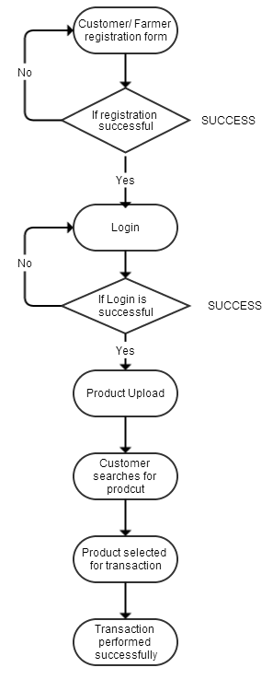
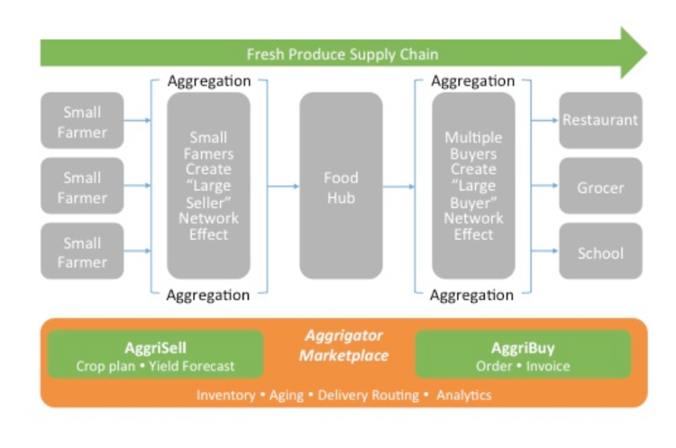
General workflow

Slide 10
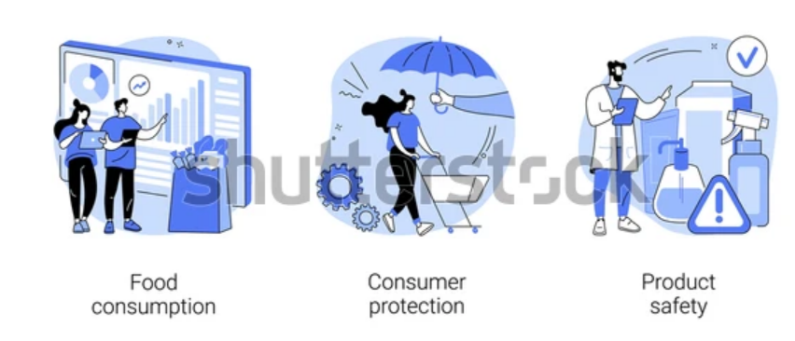
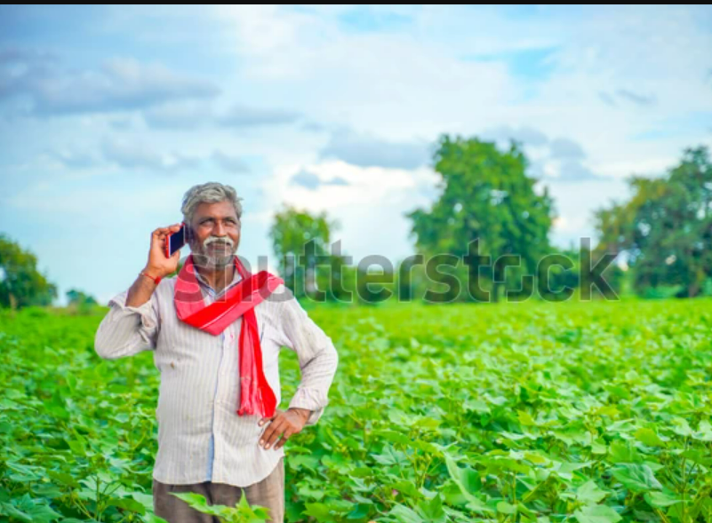
Goals

Slide 11
Functional Requirements
^{3rd party Integration}
^{Mobile Responsive website}
^{Product Attributes}
^{Order and checkout flow}
^{Social Sharing}
^{Authentication}
^{Product Tracking}

Slide 12
Non-Functional Requirements
Usability
Security
Performance
Maintainability
Scalability
Supports multi-language
Supports multi-option payments

Slide 13
System Requirements
Component | Minimum | Recommended
Processor | 1.9 gigahertz (GHz) x86- or x64-bit dual core processor with SSE2 instruction set | 3.3 gigahertz (GHz) or faster 64-bit dual core processor with SSE2 instruction set
Memory | 2-GB RAM | 4-GB RAM or more
Display | Super VGA with a resolution of 1024 x 768 | Super VGA with a resolution of 1024 x 768

Slide 14
Societal Applications
Adds transparency in the chain of farmer to customer transactions
Increase in profits for farmers
Allows customers to buy fresh and quality products for cheap costs compared to the traditional way
Interaction between farmers and customers

Slide 15
Societal Applications
farmers can leverage a huge network of social communities to sell their products at prices they deserve.
It establishes an online presence.
More customer reach.
Product promotion is easier as it is a simple process.
Farmers easily avail their necessities at one point store.
Communication makes it easier for farmers.
There will be less efforts.
Profitable income generation.

Slide 16
References
Google
Wikipedia
Famous ecommerce web applications for farmers all over the world
Articles on latest trending technologies related to agriculture
International Research Journal of Engineering and Technology (IRJET)
“E-Commerce in agri-food sector: a systematic literature review” by Yiwu Zeng, Fu Jia, Lia Wan and HongdongGuo in the International Food and Agriculture Management Review on 26 February 2017.
https://ieeexplore.ieee.org/document/8697615(Digital Market: E-Commerce Application For Farmers)

Slide 17
Thank you

